Slide 1


CHEROKEE
AQL5
www.reallygreatsite.com

Slide 2
INTRODUCTION
01
ARCHITECTURE OVERVIEW
02
KEY FEATURES
03
TECH STACK
04
THREAD POOLS
05
PERFORMANCE TESTING
06
CONCLUSION
07
INDEX
3

Slide 3
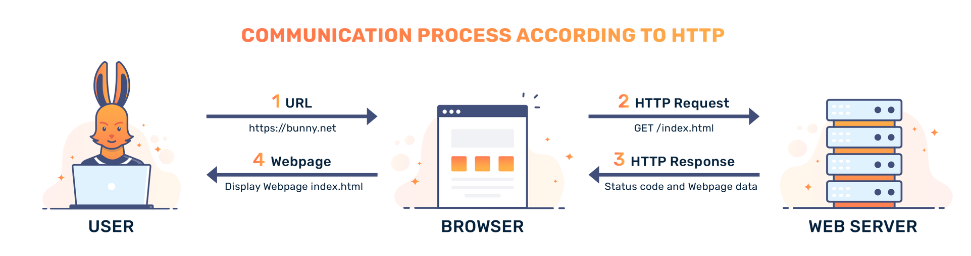
INTRODUCTION
GOAL: Implementing a simplified HTTP server using C++
4
* image source: https://bunny.net/academy/http/what-is-http-hypertext-transfer-protocol/

Slide 4
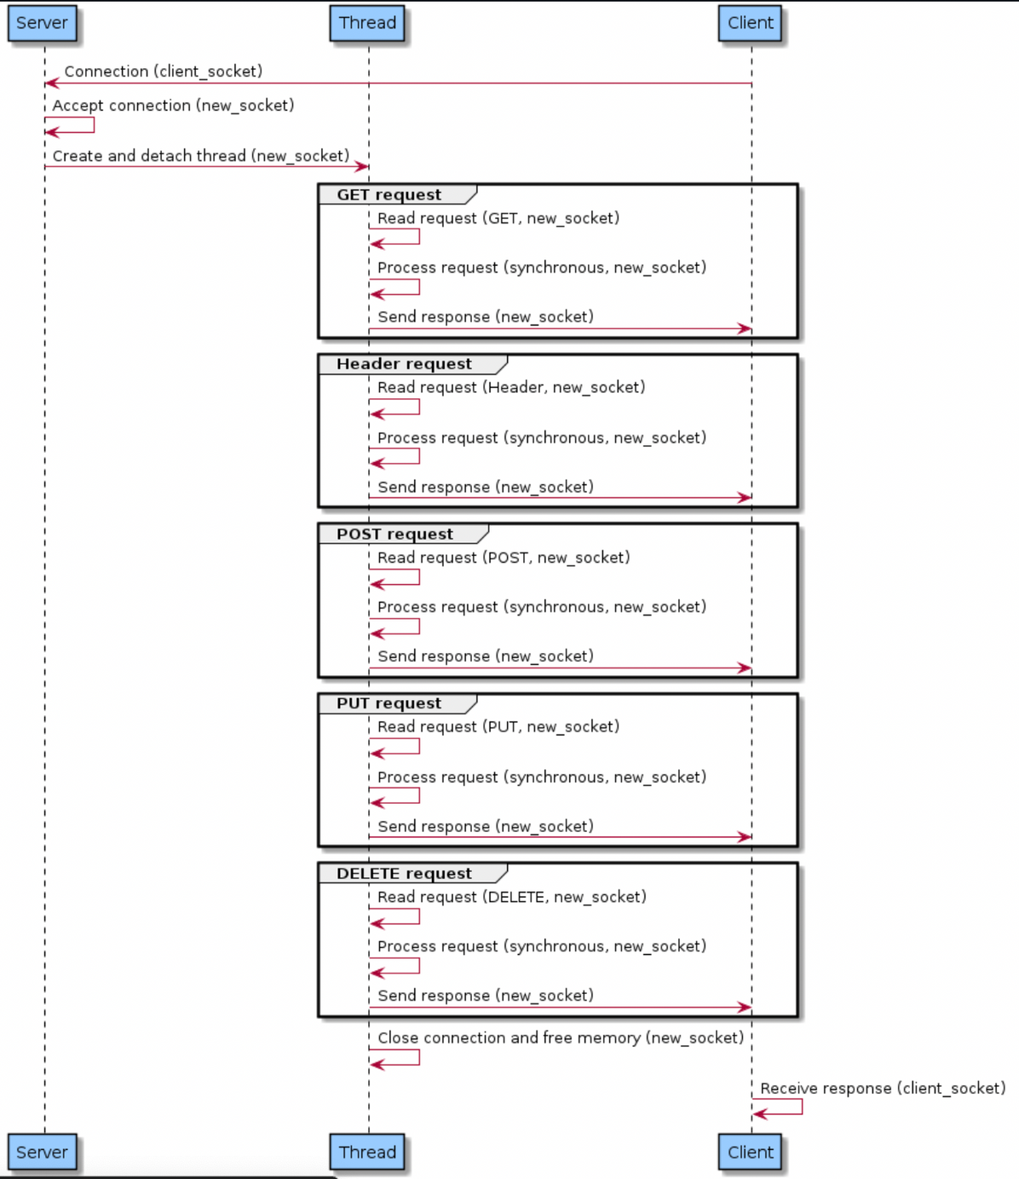
ARCHITECTURE OVERVIEW
Communication: TCP sockets for client interaction
Asynchronous Requests: Managing multiple clients simultaneously
1

Slide 5


KEY FEATURES
Implemented Methods: GET, HEAD, POST, PUT, DELETE.
File Serving: Text, HTML, JSON, JPEG, PNG.
Customizable Responses: Dynamic URL handling for CRUD operations.
Testing: Criterion and siege for comprehensive testing
6

Slide 6

TECK STACK
CRITERION
SIEGE
C++ (1994)
LANGUAGE
TOOLS

Slide 7

PERFORMANCE TESTING
Load Testing with Siege:
10 Users: siege -c 10 -t 1M http://localhost:8080
Output:
Overall after testing in different scenarios using siege, such as 10 users load up to 1000 users in a minute using the different request methods we come to the conclusion that our server is highly available and transactions are effective
Transactions: 32673 hits
Availability: 99.98 %
Elapsed time: 60.67 secs
Data transferred: 3.30 MB
Response time: 0.01 secs
Transaction rate: 538.54 trans/sec
Throughput: 0.05 MB/sec
Concurrency: 5.99
Successful transactions: 32673
Failed transactions: 5
Longest transaction: 19.52
Shortest transaction: 0.00
Availability
18

Slide 8
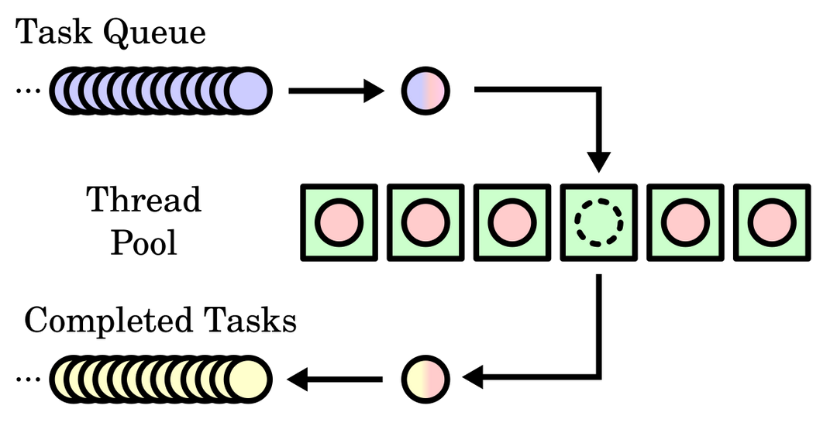
EXPLORATION:
THREAD POOLS
INITIAL IDEA:
IMPROVE PERFORMANCE USING THREAD POOLS.
AIM: REDUCE OVERHEAD BY REUSING THREADS FOR MULTIPLE REQUESTS.
RESULTS:
MIXED PERFORMANCE GAINS:
PROS: REDUCED LATENCY, BETTER RESOURCE UTILIZATION.
CONS: INCREASED COMPLEXITY, THREAD CONTENTION, INCONSISTENT PERFORMANCE.
4

Slide 9
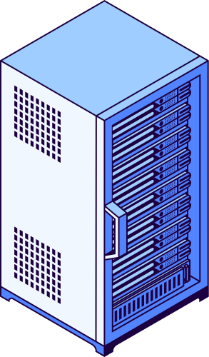
CONCLUSION
We implemented a basic HTTP server with key functionalities
Our Future Work could be:
Exploring thread pools further in a search for performance improvement
Adding more HTTP features such as: Rate Limiting and Throttling, Persitent Connections and much more

Slide 10
THANK YOU

